Slide 1

Vivekanand College, Kolhapur (Empowered Autonomous) Department of Computer Science
“Online Web Portal for Green Metrics Calculations and analysis”
B.Sc. III (Computer Science) 2023-24
Submitted by:
1.Priya Shivling Koneri .
2.Supriya Krishnat Kumbhar .
3.Pradnya Arun Mali .
4.Mrunali Maruti Patil .

Slide 2
Content
Introduction
Objectives
Motivation
Methodology
Existing Systems
Project Plan
Database Development
Conclusion

Slide 3
Introduction
The "Online Web Portal for Green Metrics Calculations and Analysis" is a visionary software project designed to calculate green metrics easily. By harnessing the power of technology, this project aims to provide users with a robust and user-friendly solution for measuring, analysing, and reducing their environmental footprint.
The chemistry department has been conducting research on the "Green Metrics" and the challenging aspect of their research has been performing 15-20 calculations for each product. Thus, with this project, we have created software that has made these calculations easier and faster.

Slide 4
Objectives
To measure the efficiency and environmental performance of chemical processes.
To minimize errors while performing green metrics calculations manually.
To compare the various chemical processes and to choose best among them for further experimentation.
To represent chemical process data graphically for better analysis.

Slide 5
Motivation
The motivation for doing this project was primarily an interest in undertaking a challenging project in an interesting area of research .
We are grateful to our project guide and Chemistry Department for showing faith in us and giving this project for developing a "Online Web Portal for Green Metrics Calculations and Analysis"
This tool will make it easy for everyone to take meaningful steps towards a greener and more eco-friendly future. Together, we can make a big difference, one calculation at a time.

Slide 6
Methodology
Gathered requirements from chemistry department and users.
Planned system architecture and design.
Implemented software according to plans.
Tested software thoroughly, both inside and out.
Deployed software to production environment and provided ongoing support.

Slide 7
Existing Systems
This are the active existing systems:-
PMI Predictor :Calculates process mass intensity (PMI) for a chemical synthesis route using the sequence of synthetic steps and step information.
AMGS Calculator :Calculates an analytical method greenness score (AMGS) to enable the comparison of separation methods used in drug development.
Chemotion : Open Source electronic lab notebook for researchers with a green chemistry tab.

Slide 8
Project Plan
Phase 1: Requirements Gathering
Have gathered needs from chemistry department and users.
Have identified specific functionalities and data requirements.
Phase 2: System Design
Have planned software architecture and layout.
Have created diagrams to visualize system structure.
Phase 3: Implementation
Have developed software based on design.
Have included login/signup, calculation, and data display features.
Phase 4: Testing
Have checked software thoroughly for bugs and errors.
Have let users try it out for feedback.
Phase 5: Deployment and Maintenance
Have put software where users can access it.
Continue to provide support, fixing issues and making improvements.

Slide 9
Development Environment
Scripting Language | Python
Framework | Flask microweb-framework
Designing and Scripting Language | HTML, CSS
DBMS Environment | MySQL
Open-Source Libraries | MySQL Connector, fpdf, matplotlib

Slide 10
Database Development
1.Table Name: userDetails
Field Name | Data Type | Constraint
id | int | Primary key auto-increment Not null
username | varchar(50) | Not null
password | varchar(50) | Not null
email | varchar(50) | Not null

Slide 11
2.Table Name: green_metrics_data
Field Name | Data Type | Constraint
product-name | varchar(40) | Primary key Not null
yeild | float | Primary key Not null
time | float | Primary key Not null
emy | float | Not null
ae | float | Not null
aef | float | Not null
ce | float | Not null
rme | float | Not null
oe | float | Not null
pmi | float | Not null
mi | float | Not null
mp | float | Not null
e-factor | float | Not null
si | float | Not null
wi | float | Not null
ton | float | Not null
tof | float | Not null
user | varchar(40) | Primary key Not null

Slide 12
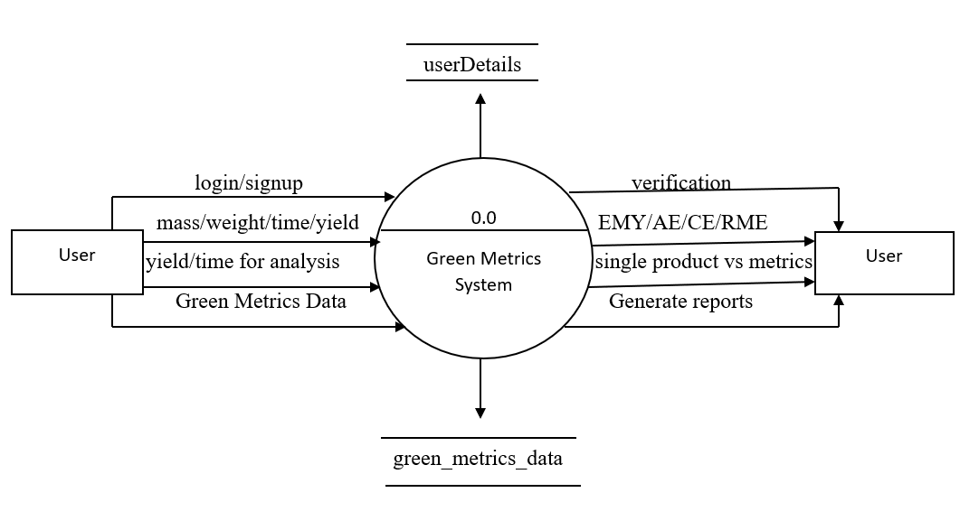
DFD Diagram:

Slide 13
Conclusion
The "Online Web Portal for Green Metrics Calculations and Analysis" project promises to revolutionize environmental impact assessment by providing a user-friendly platform for calculating and tracking sustainability metrics.
Its automated calculations and customizable parameters offer significant time savings and accuracy improvements, empowering users to make informed decisions towards environmental stewardship. With its comprehensive features and benefits, the Green Metrics Calculator and Analyzer has the potential to become an indispensable tool for businesses and organizations striving for sustainable practices.

